Slide 1
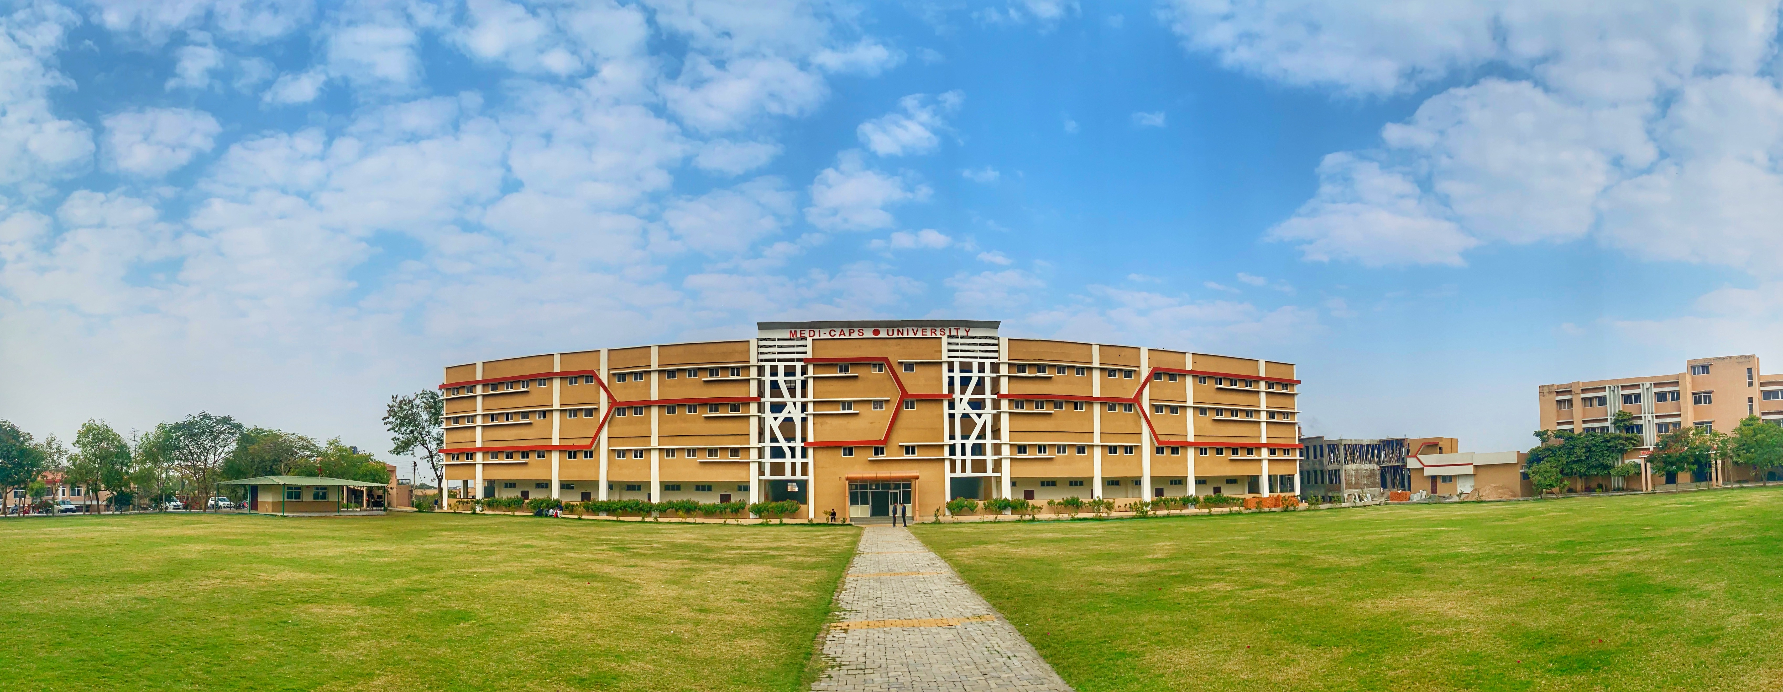

Engineering Physics (EN3BS05)
Ms Bhawna Kshirsagar
Medi-Caps University, Indore

Slide 2
Syllabus
Unit 1. Lasers and Optical Fibre
Unit 2. Interference and Diffraction
Unit 3. Quantum Mechanics
Unit 4. Mechanics and Crystal Physics
Unit 5. Polarization, Acoustics and Superconductivity

Slide 3
Scheme 3-1-2
3- Lectures
1- Tutorial
2- Laboratory Work
Total Credit: 5
Ms. Bhawna Kshirsagar , Assistant Professor (Physics Department) Medi-Caps University, Indore

Slide 4
EN3BS05 Engineering Physics 3-1-2
Text Books
Text Book of Optics by S. Chand Publication
Gour and Gupta , Engineering Physics, Dhanpat Rai Publication
S. L. Gupta, Engineering Physics
Text Book of Engineering Physics by M.N. Avadhanulu and P.G. Kshirsagar (Acoustics, Superconductivity)
Reference Books
Dr. M. N. Avadhanulu, Dr. R. S. Hemne, An Introduction to Laser- Theory and Applications. S. Chand Publications
Web Resources
http://phet.colarado.edu/en/simulations.
http://nptel.ac.in/courses/122103011/39.
Ms. Bhawna Kshirsagar , Assistant Professor (Physics Department) Medi-Caps University, Indore

Slide 5
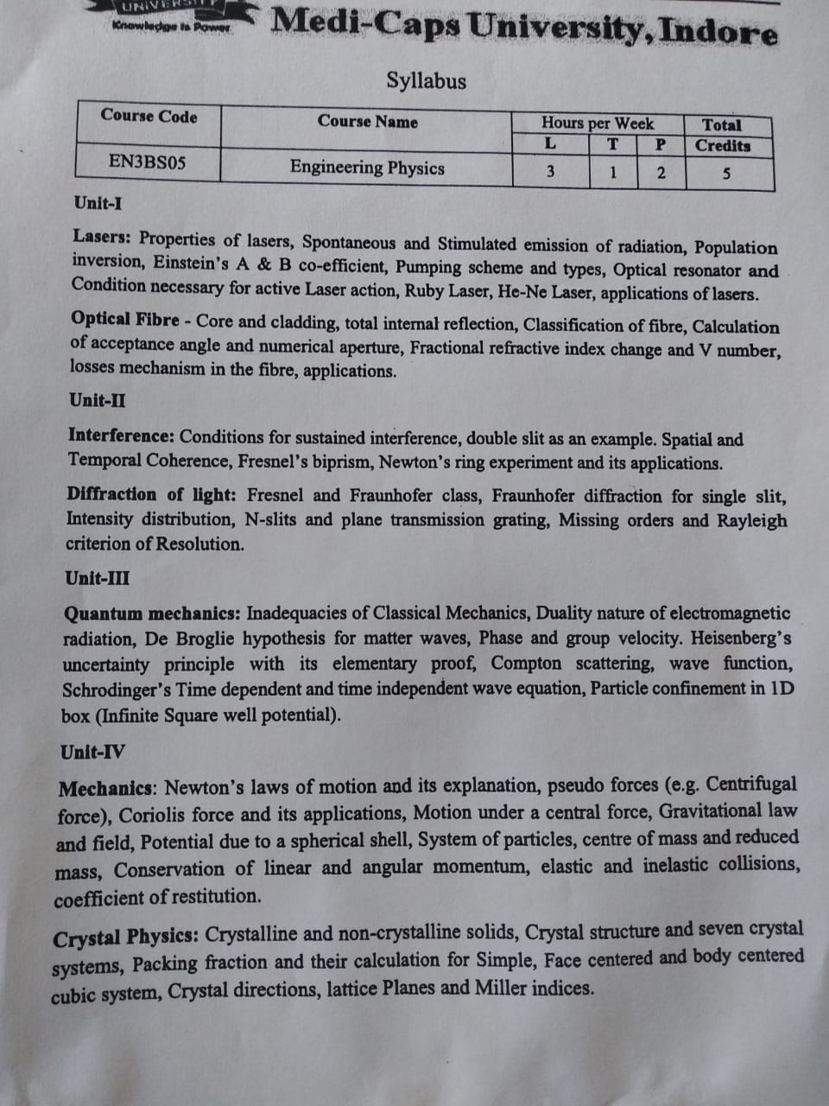

Slide 6
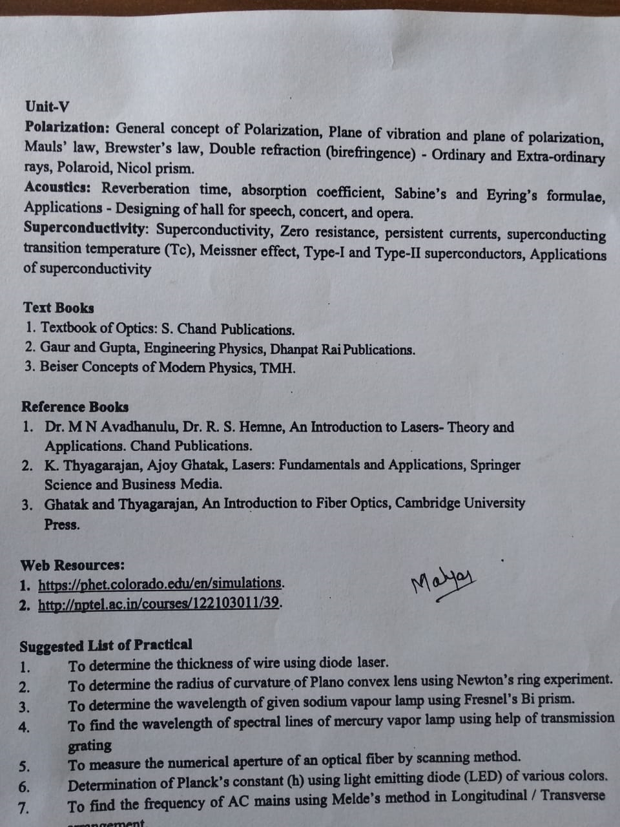

Slide 7
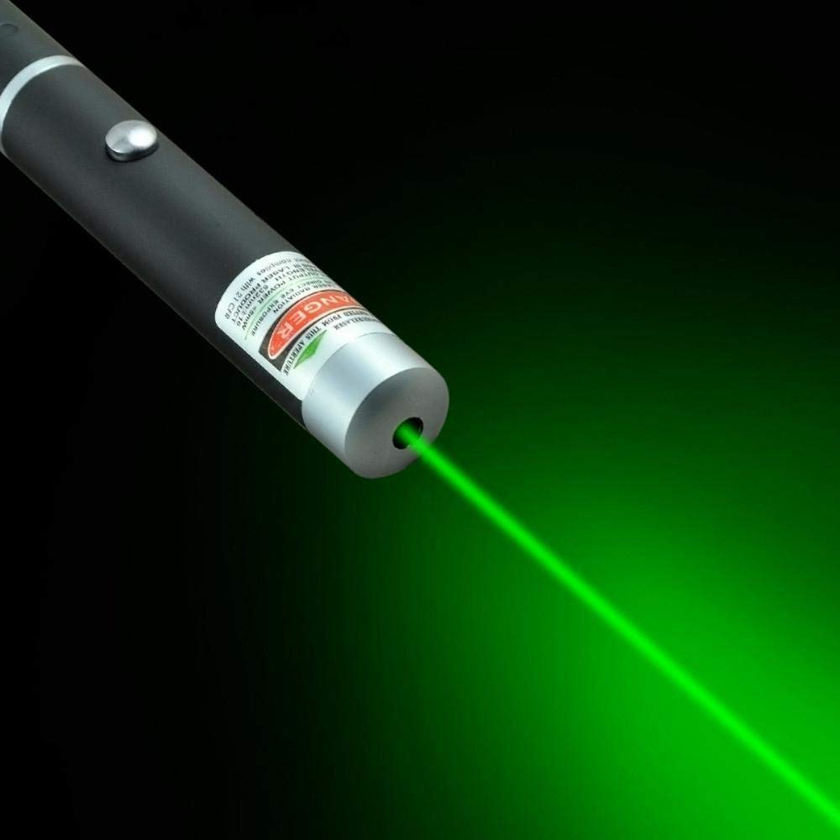
Unit 1: Laser and Optical Fibre
Laser

Slide 8
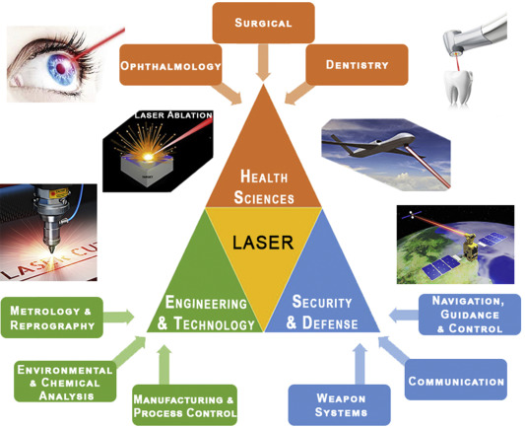
Applications

Slide 9
Laser Abbreviation and Definition
“Light Amplification by Stimulated Emission of Radiation”
A device which produces highly coherent, monochromatic and intense beam of light.
A device produces a coherent beam of optical radiation by stimulating electrons to higher energy levels. When they return to lower energy levels by stimulated emission, they emit energy.

Slide 10
Principle of Laser
Stimulated Emission of Radiation

Slide 11
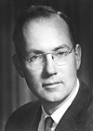
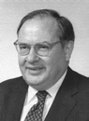
History of LASER
• Invented in 1958 by Charles Townes (Nobel prize in Physics 1964) and Arthur Schawlow of Bell Laboratories
• Was based on Einstein’s idea of the “particle wave duality” of light, more than 30 years earlier
• Originally called MASER (m = “microwave”, 1mm -1m)
or 10⁷-10¹⁰Å

Slide 12
Characteristics of Laser
The light emitted from a laser is monochromatic, (one color/wavelength). In contrast, ordinary light is a combination of many colors (or wavelengths) of light.
Lasers is highly directional , that is, laser light is emitted as a relatively narrow beam in a specific direction. Ordinary light, such as from a light bulb, is emitted in many directions away from the source.
The light from a laser is said to be coherent, which means that the wavelengths of the laser light are in phase in space and time. Ordinary light can be a mixture of many wavelengths.

Slide 13
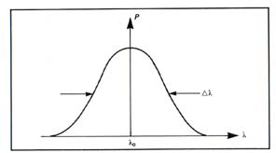
Monochromacity
Nearly monochromatic light
Example:
He-Ne Laser
λ0 = 632.5 nm
Δλ = 0.2 nm
Diode Laser
λ0 = 900 nm
Δλ = 10 nm

Slide 14

Incandescent vs. Laser Light
Many wavelengths
Multidirectional
Incoherent
Monochromatic
Directional
Coherent

Slide 15
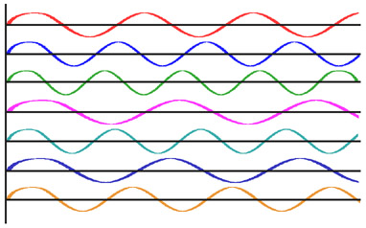
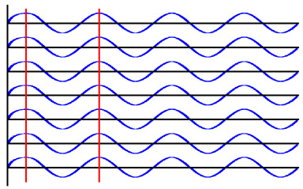
Coherence
Incoherent light waves Coherent light waves

Slide 16
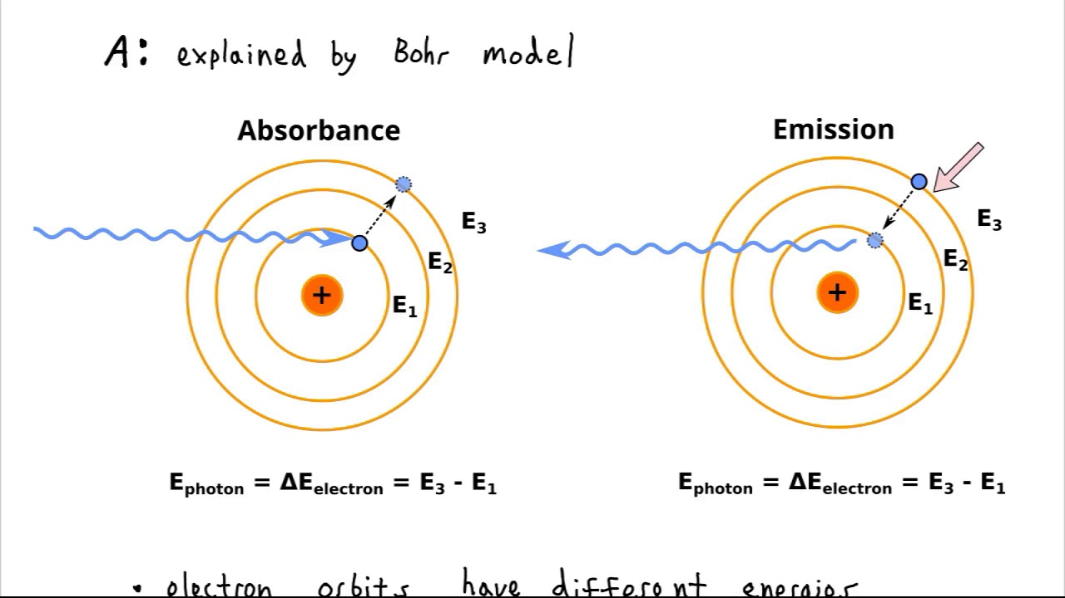
Quantum Processes Involved in Laser
Absorption
Spontaneous Emission
Stimulated Emission

Slide 17
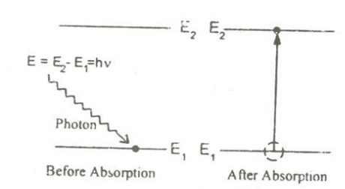
1. Absorption of Radiation
An atom in the lower energy level or ground state energy level E1 absorbs the incident photon radiation of energy hv and goes to the higher energy level or excited level E2 as shown in figure.
E₂-E₁= E
E is the energy of incident photon

Slide 18
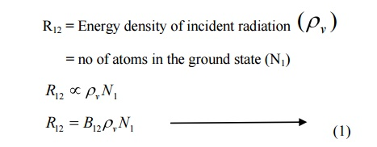
Absorption of Radiation contd……..
If there are many numbers of atoms in the ground state then each atom will absorb the energy from the incident photon and goes to the excited state. then,
The rate of absorption (R12) is proportional to the following factors.
Where ρ_{ν} is the energy density of incident radiation.
B₁₂ is a constant which gives the probability of absorption or absorption transition per unit time. Also called as Coefficient of Absorption.
Normally, the atoms in the excited state will not stay there for a long period of time , rather it comes to ground state by emitting a photon of energy E=hν. Such an emission takes place by one of the following two methods.

Slide 19
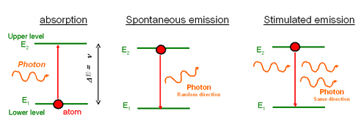
2. Spontaneous emission: (Self Emission)
An atom in an upper level can decay spontaneously to the lower level and emit a photon of frequency hν if the transition between E2 and E1 is radiative.
Spontaneously without any external triggering
This photon has a random direction and phase.
This emission is independent of incident radiation.

Slide 20
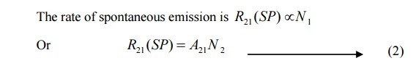
If N₁ and N₂ is the Population of (numbers of atoms) in the ground state (E₁) and excited state (E₂) respectively, then
Rate of spontaneous emission
Where A₂₁ is a constant which gives the probability of spontaneous emission transitions per unit time.
Also called as Coefficient of Spontaneous Emission

Slide 21
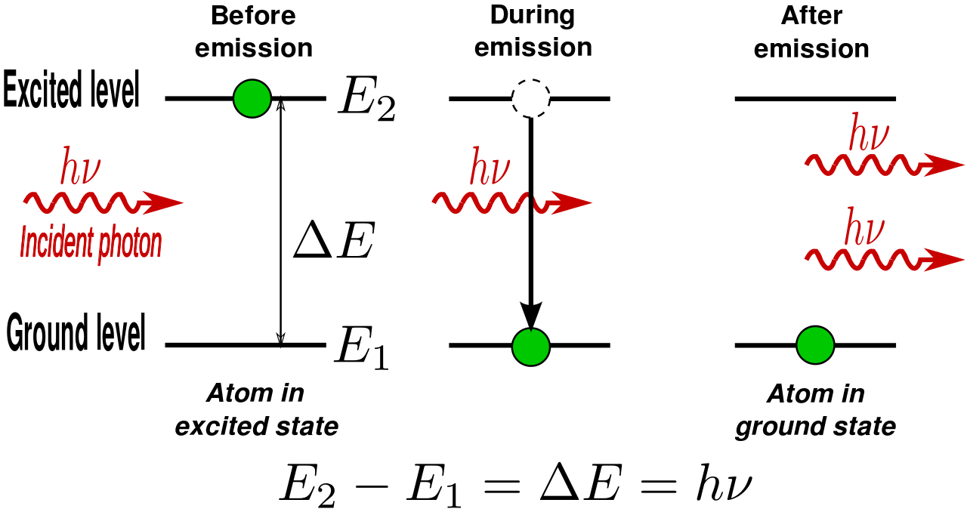
3. Stimulated emission: (Induced Emission)
Stimulated emission is the process by which an incoming photon of a specific frequency can interact with an excited electron (or other excited molecular state), causing it to drop to a lower energy level.

Slide 22
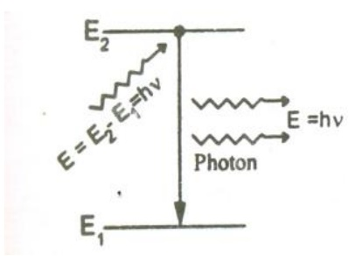
Thus results in two photons of same energy, phase difference and of same directionality as shown.
3. Stimulated emission Contd……………..
The atom in the excited state can also return to the ground state by external triggering or inducement of photon thereby emitting a photon of energy equal to the energy of the incident photon, known as stimulated emission. Thus results in two photons of same energy, phase difference and of same directionality

Slide 23
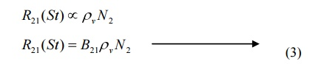
Stimulated emission Contd……………..
Therefore, the rate of stimulated emission is given by
Where B₂₁ is a constant which gives the probability of stimulated emission transitions per unit time.
Also called as Coefficient of Stimulated Emission

Slide 24
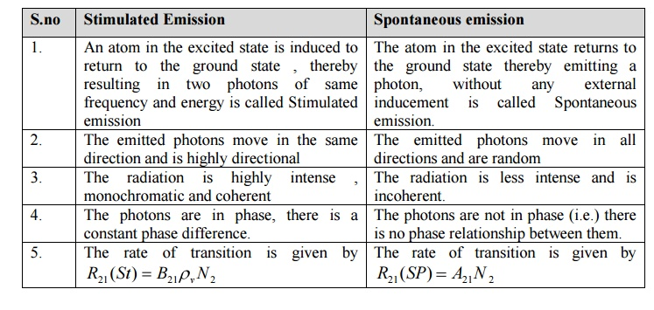
Difference between spontaneous and Stimulated emission

Slide 25
Give examples of Spontaneous and Stimulated emission??

Slide 26
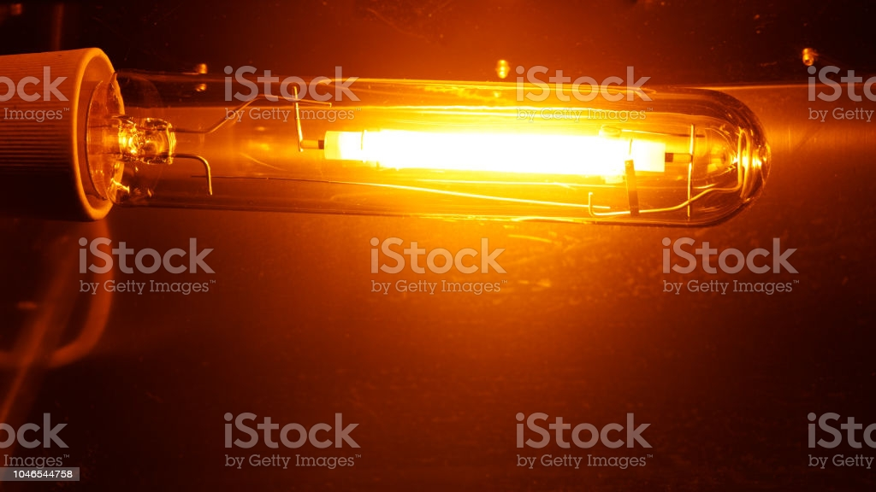
Spontaneous Emission : Ordinary Light Sources like Sodium Lamp, Mercury Lamp, Sun, Moon, Fire etc……
Stimulated Emission : LASER

Slide 27
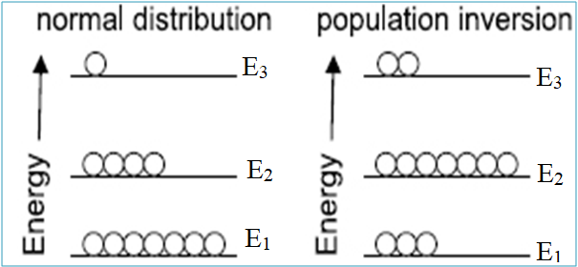
Einstein’s A and B co-efficient
under thermal equilibrium, the population of energy levels obeys the Boltzmann distribution law (N₁>N₂ )
Under thermal equilibrium
The rate of absorption = The rate of emission
N₁ and N₂ is the Population of (numbers of atoms) in the ground state (E₁) and excited state (E₂) respectively
( N₂ )
( N₁ )

Slide 28
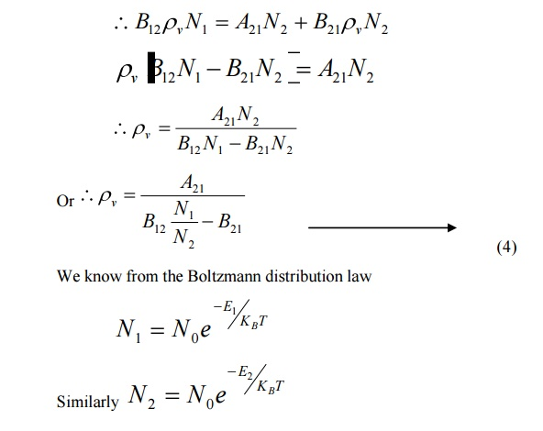
The rate of absorption = the rate of emission
Where
K_{B} is the Boltzmann Constant,
T is the absolute temperature
N₀ is the number of atoms at absolute zero.

Slide 29
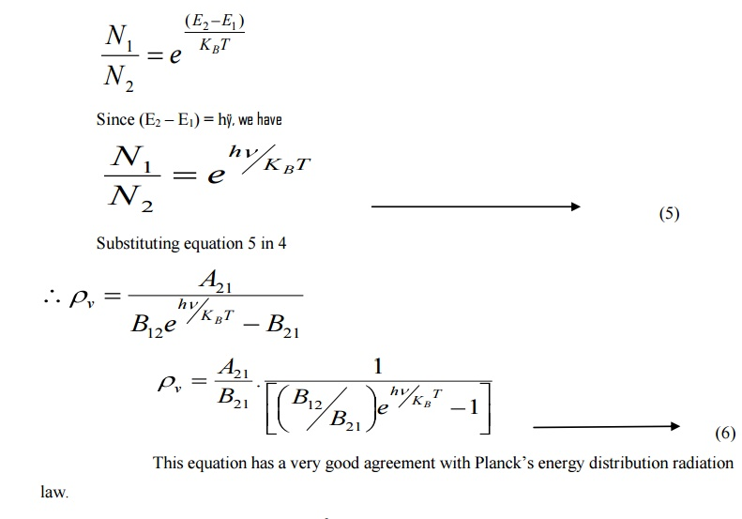
At equilibrium,

Slide 30
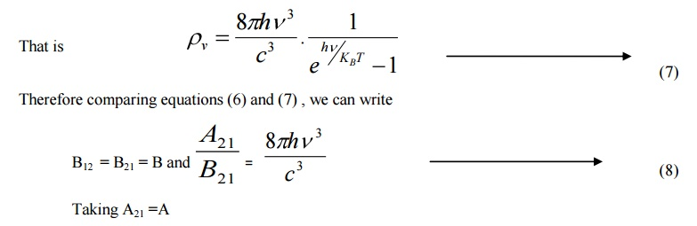
According to Planck’s Law of Black Body Radiation
Above relation represents the probability of spontaneous and stimulated emission. So it is difficult to achieve laser action in higher frequency ranges like X-rays

Slide 31
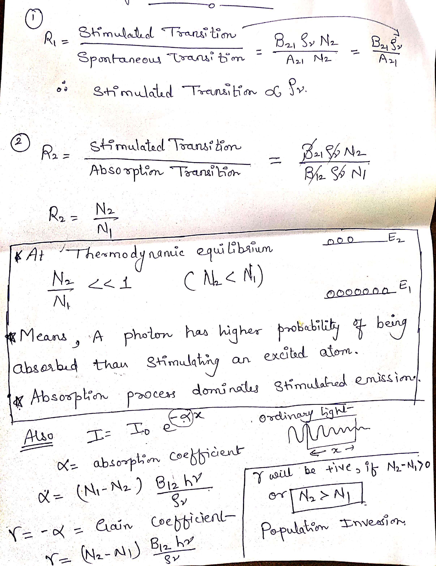
Conditions for Large Stimulated Emission
Energy density should be large
N₂ > N₁
should be low

Slide 32
Population Inversion
A state in which more atoms or molecules are in a higher excited state . N₂>N₁
Population Inversion between E₁ and E₂

Slide 33
Lower energy state (N1)
Higher energy state (N2).
E2
E1
Prof. (Dr.) Sunil K. Somani and Prof. (Dr.) Shilpa Tripathi, Medi-Caps University, Indore

Slide 34
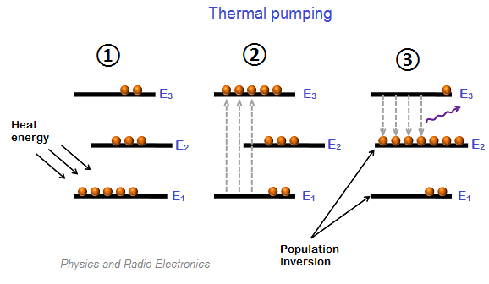
Population Inversion Contd…………
Population of higher energy state is more than lower energy state.
N₂ > N₁
Also called “Negative Temperature State”.

Slide 35
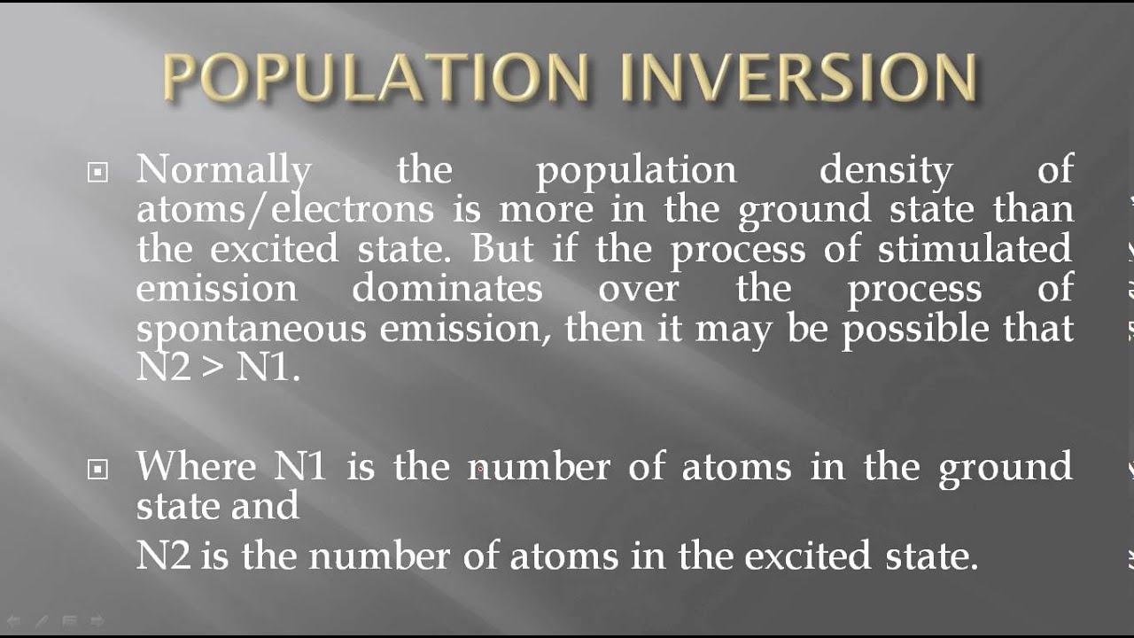
Population Inversion Contd…………..

Slide 36
Meta Stable State and Active medium
MSS is an excited state of an atom with a longer lifetime than the other excited states.
The life time at meta stable state is 10⁻⁶ to10⁻³ sec.
Achieved by adding impurities to pure material.
No MSS No Population Inversion No Stimulated Emission No Laser

Slide 37
Lower energy state
Higher energy state.
E2
E1

Slide 38
Meta Stable State contd……
An atom can be excited to a higher level by supplying energy to it. Normally, excited atoms have short life times and release their energy in a matter of nano seconds (10-9) through spontaneous emission. It means atoms do not stay long to be stimulated. As a result, they undergo spontaneous emission and rapidly return to the ground level; thereby population inversion could not be established. In order to do so, the excited atoms are required to ‘wait’ at the upper energy level till a large number of atoms accumulate at that level. In other words, it is necessary that excited state have a longer lifetime. A Meta stable state is such a state. Metastable can be readily obtained in a crystal system containing impurity atoms. These levels lie in the forbidden gap of the host crystal. There could be no population inversion and hence no laser action, if metastable states don’t exist.

Slide 39
Active medium
Active medium constitutes two types of atoms called host and active centre.
Active centre: Directly participated in lasing.
Host : Supports active centre.

Slide 40
PUMPING
The process to achieve the population inversion in the medium is called Pumping.
Methods of pumping action:
The methods commonly used for pumping action are:
1. Optical pumping (Excitation by Photons)
2. Electrical discharge method(Excitation by electrons)
3. Direct conversion
4. In elastic atom – atom collision between atoms

Slide 41
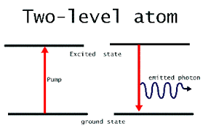
Pumping Schemes
Two Level pumping
*Not suitable for attaining Population Inversion

Slide 42
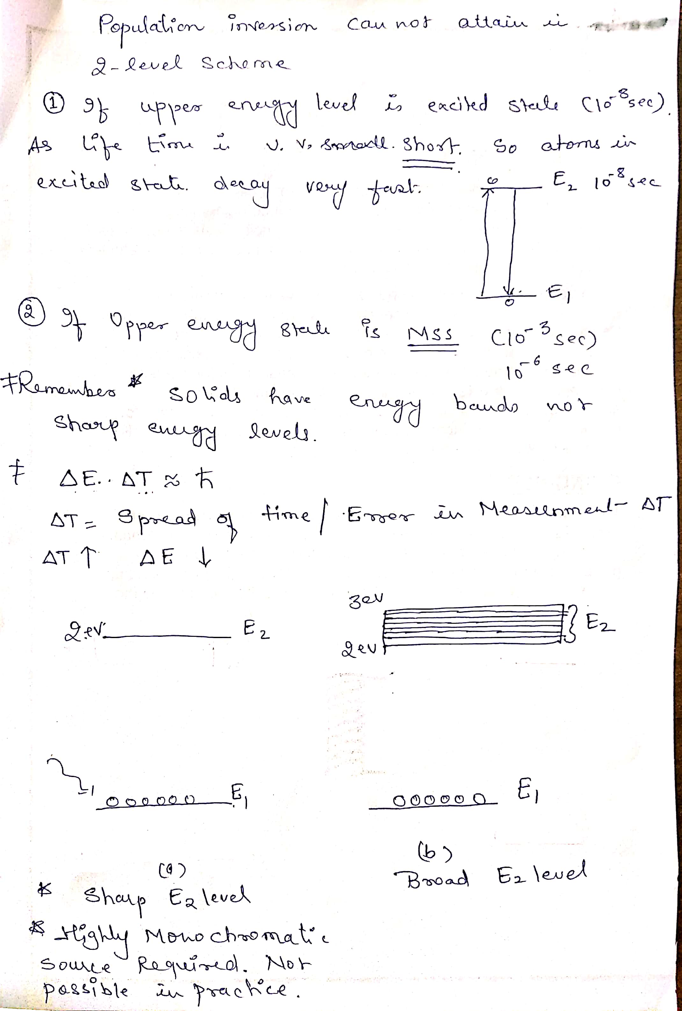
Ms Bhawna Kshirsagar Medi-Caps University, Indore

Slide 43
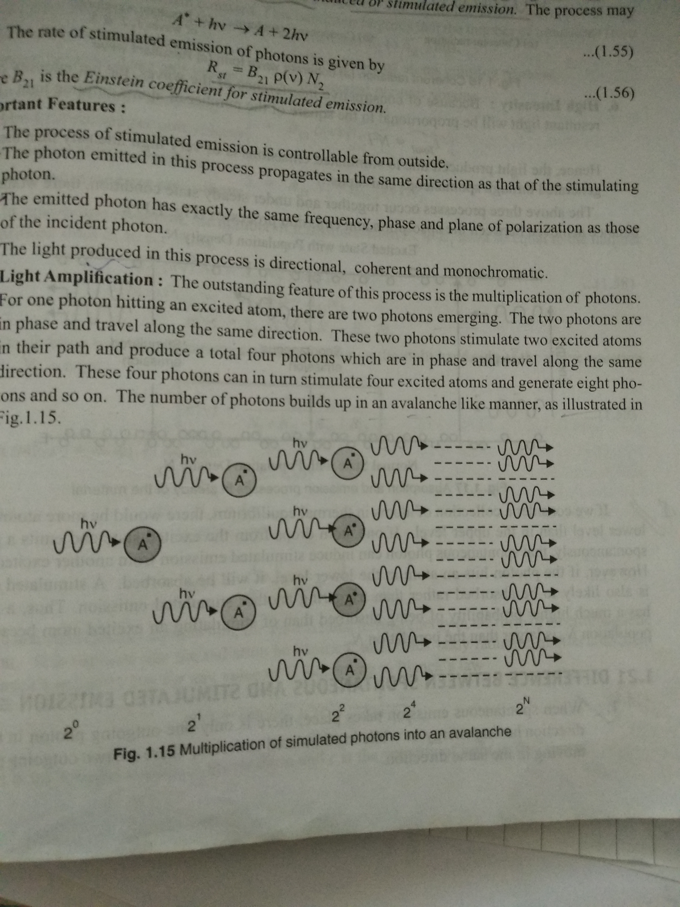
How Amplification takes place in Laser
Ms Bhawna Kshirsagar Medi-Caps University, Indore

Slide 44
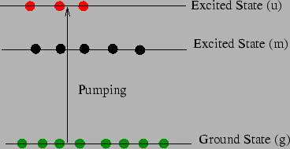
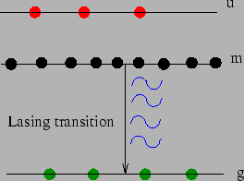
Three Level Pumping
Thermal Equilibrium
Population inversion
E₁-Ground State
E₂- mss
E₃- Excited State
Radiation less transition from E₃ to E₂
Population inversion established between E₂ and E₁ when N₂>N₁/2
More than half of G S atoms are pumped to higher energy state
Output is pulsed
Terminating level is ground level
Radiation less transition
MSS
Ms Bhawna Kshirsagar Medi-Caps University, Indore

Slide 45
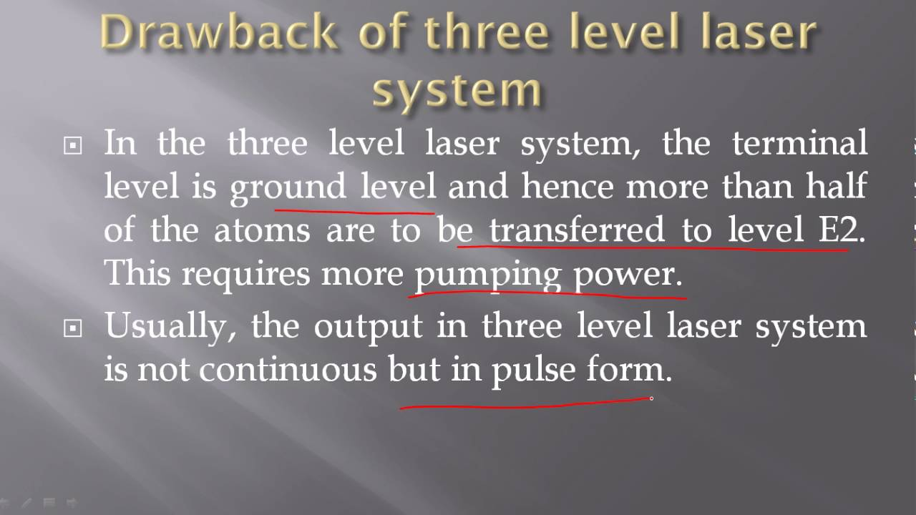
Ms Bhawna Kshirsagar Medi-Caps University, Indore

Slide 46
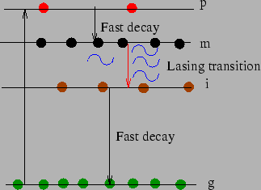
Four Level Pumping
Terminating laser level E₂ is well above the ground level
E₂ is virtually empty
Population inversion is quickly established between E₃ and E₂
Less pump power is needed
Output is continuous
Ms Bhawna Kshirsagar Medi-Caps University, Indore

Slide 47
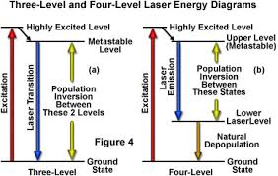
Ms Bhawna Kshirsagar Medi-Caps University, Indore

Slide 48
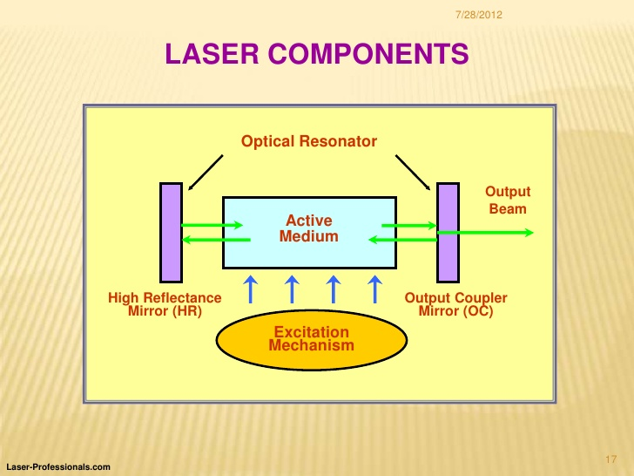
Components Of Laser
Energy Source
Active Medium
Optical Resonator
Fully reflecting mirror
Partially reflecting mirror
Energy Source
Ms Bhawna Kshirsagar Medi-Caps University, Indore

Slide 49
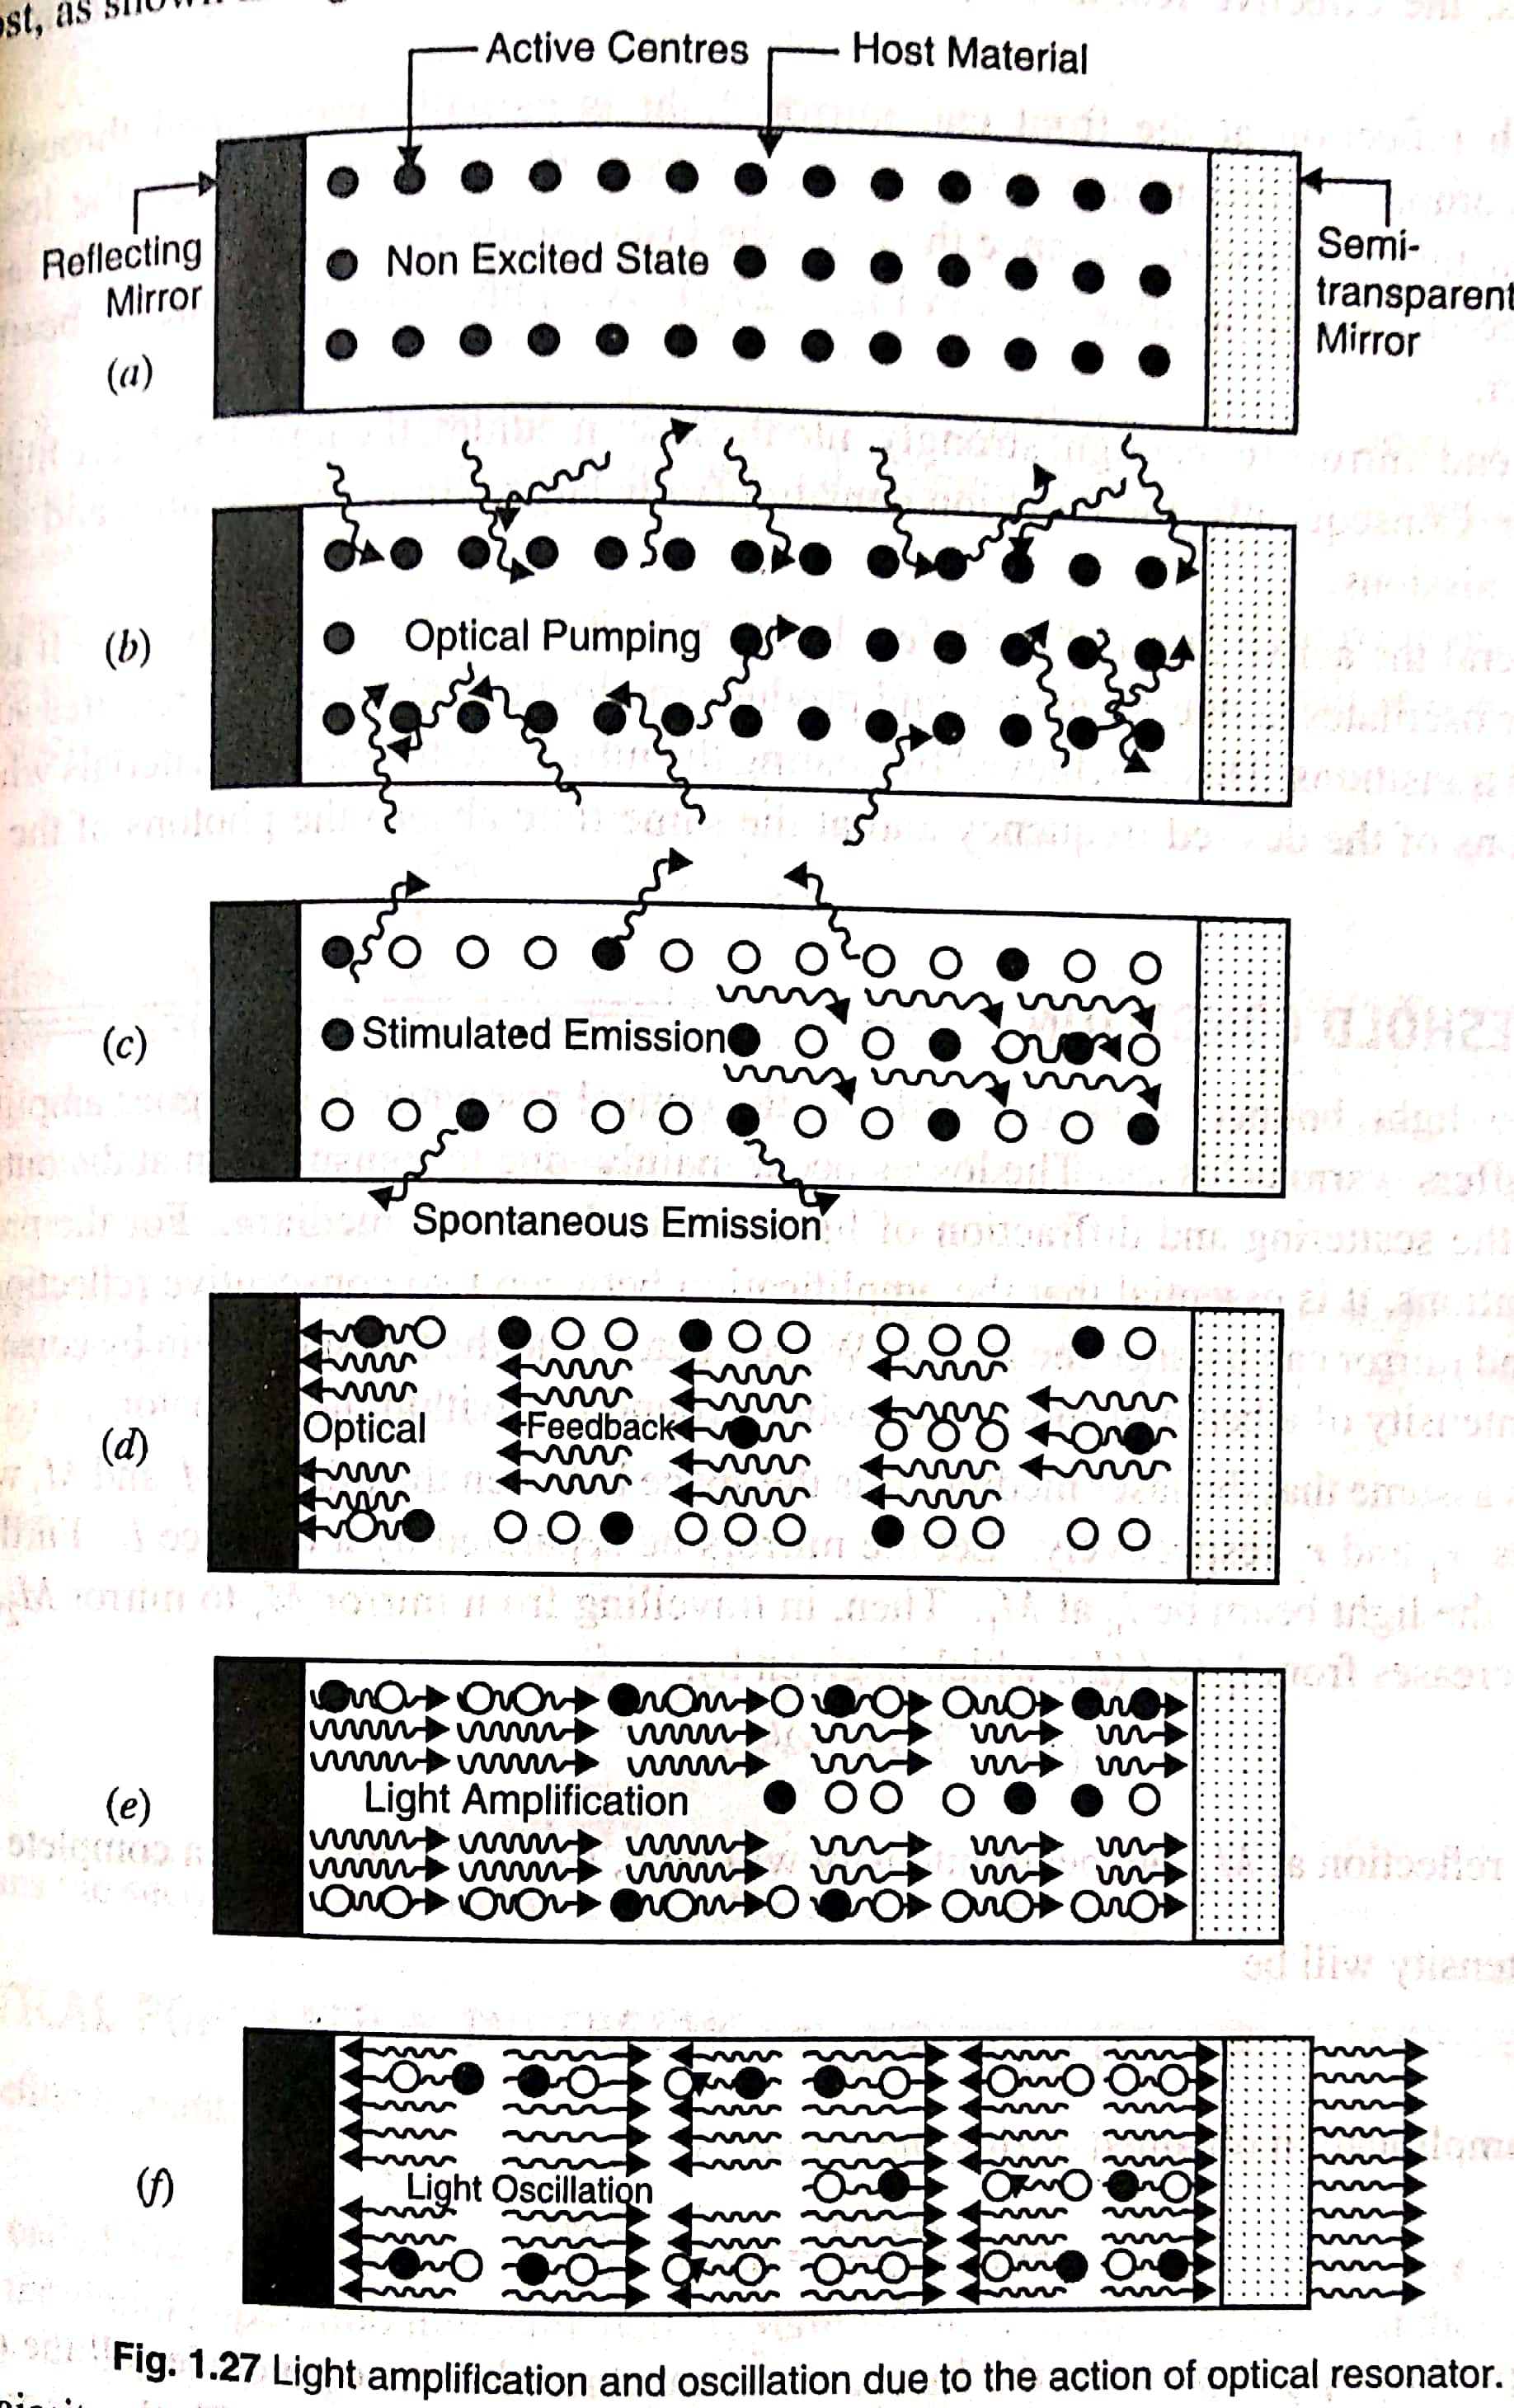
Ms Bhawna Kshirsagar Medi-Caps University, Indore

Slide 50
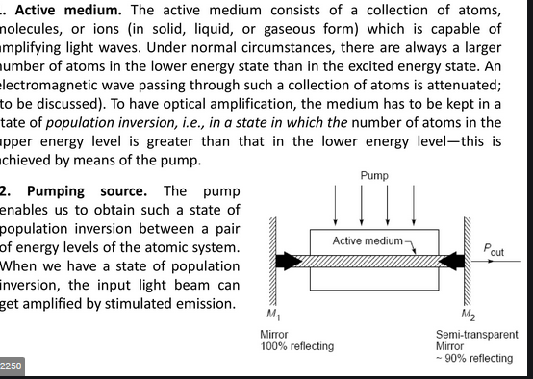
Ms Bhawna Kshirsagar Medi-Caps University, Indore

Slide 51
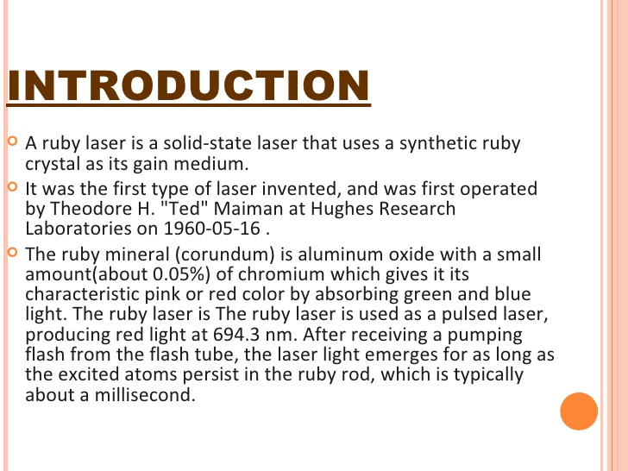
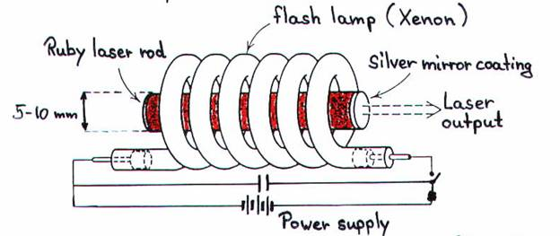
Ruby Laser
Ms Bhawna Kshirsagar Medi-Caps University, Indore

Slide 52
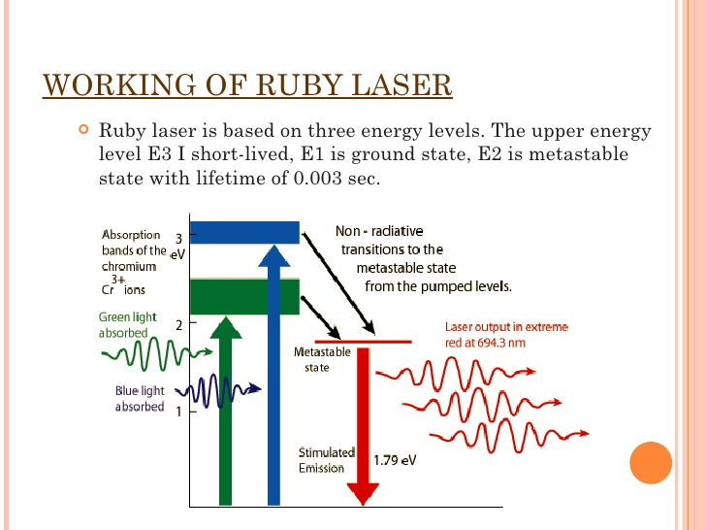
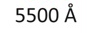
Ruby Laser Contd…..

Slide 53
Ruby Laser Contd…..
Features:
High energy storage capacity
Pulse energy up to 100 joules
Drawbacks:
High pump power is required
Low efficiency (Only green and blue components are utilized)
Output is pulsed
Applications:
Drilling holes in hard materials
High-brightness holographic camera systems
Medical laser systems for tattoo removal and cosmetic dermatology
High-power Q-switched system.
Ms Bhawna Kshirsagar Medi-Caps University, Indore

Slide 54
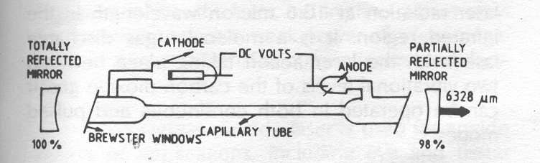
HELIUM NEON LASER
Four level laser
Gaseous laser
One of the most widely used laser
Electrical Discharge is used
Active centres are Neon atoms and He is host
The active medium consists of 10 parts of He and 1 part of Ne
Operates in CW mode having long operating tie 50,000 hrs
Built in 1961 by Ali Javan, Bennett, and Herriott at Bell Telephone Laboratories

Slide 55
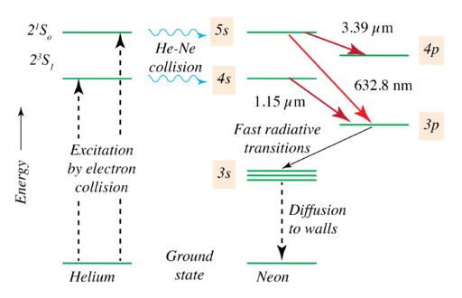
He-Ne Laser : Energy Level Diagram
The three possible transitions E₆ E₃ (vissible) E₆ E₅ E₄ E₃

Slide 56
A high voltage of 10 kV is applied
He atoms are excited to 19.81eV and 20.61 eV respectively
He atoms transfer their energy to ground state Ne atoms (resonant energy transfer)
Ne atoms excited to E₄ and E₆ levels (mss)
E₂ is again mss
Brewster window is used to polarized the light
Resonator mirrors are coated with dielectric material

Slide 57
Applications: Used as a monochromatic source in laboratories Bar code scanner Laser guns for targeting Advantages: Good coherence property Large operating time Disadvantages: High power is required Output power is low Extra skills required

